Slide 1
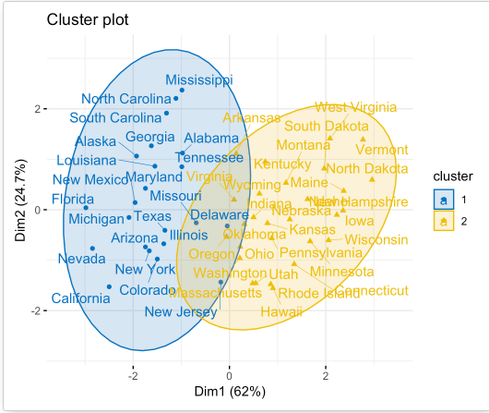
Points belong to L1
Ideas
Fuzzy Clustering
Points belong to L2
L1
L2
Potential Transfer Points that we can start from L1 to L2, and vice versa

Slide 2
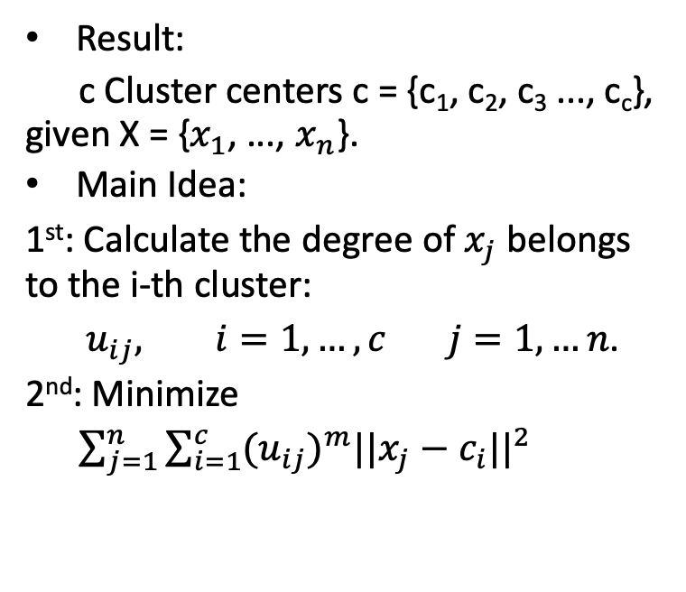
Fuzzy C-Means Clustering (FCM) Algorithm
Result:
c Cluster centers c = {c₁, c₂, c₃ ..., c_{c}}, given X = {$x_{1}$, ..., $x_{n}$}.
Main Idea:
1st: Calculate the degree of $x_{j}$ belongs to the i-th cluster:
$u_{ij}, i=1,…,c j=1,…n$.
2nd: Minimize
$\sum_{j=1}^{n}{\sum_{i=1}^{c}{{{{(u}_{ij})}^{m}||{x_{j}−c}_{i}||}^{2}}}$

Slide 3
Fuzzy C-Means Clustering (FCM) Algorithm
Advantages:
Gives best result for overlapped data set.
Data point may belong to more then one cluster center.
Disadvantages:
A priori specification of the number of clusters.
Euclidean distance measures can unequally weight underlying factors.

Slide 4
Ideas
Assuming the capacity of each driver as their average level calculated from their old experience, for example, D1 has capacity of 7 orders, D2 has capacity of 8 orders, D3 has capacity of 7…
12 orders
L2
L1
CVRP
20 orders
L3
7 orders

